Slide 1
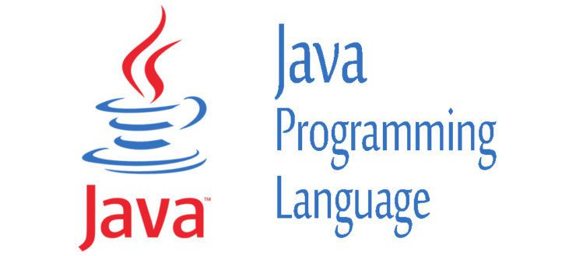
PROJET JAVA/POO/UML
SUPERVISED BY :
MR TAWAMBA

Slide 2
TEAM PRESENTATION
DJONDANG AOUDOU(Chef Projet)
KANAA ALBERT
JODOM MARLENE
TSAGUE DONFACK LOIC

Slide 3
TABLE OF CONTENT
PROJECT PRESENTATION
GANTT
DESCRIPTION OF TOOLS USED
APPLICATION PRESENTATION
UML DIAGRAMS
CONCLUSION

Slide 4
PROJECT PRESENTATION
CONTEXT
It's about rewriting an old game (1984) Boulder Dash created by Peter Liepa and Chris Gray, about which the principle of the game is to collect a defined number of diamonds to open a passage to the next level. The character, nicknamed Rockford, must dig the earth to make his way. He will have to be careful not to be crushed by a rock or a diamond but also not to make enemies touch.
OBJECTIVES
Rewrite an old game named Lorann
Lorann have to pick up some objects, especially diamonds to finish the level, and fight monsters to gain more diamonds
It must be a Maven Project written in JAVA language, and composed of five levels.
Use of a database to access different levels
Player’s displacement/movement
Class Diagram

Slide 5

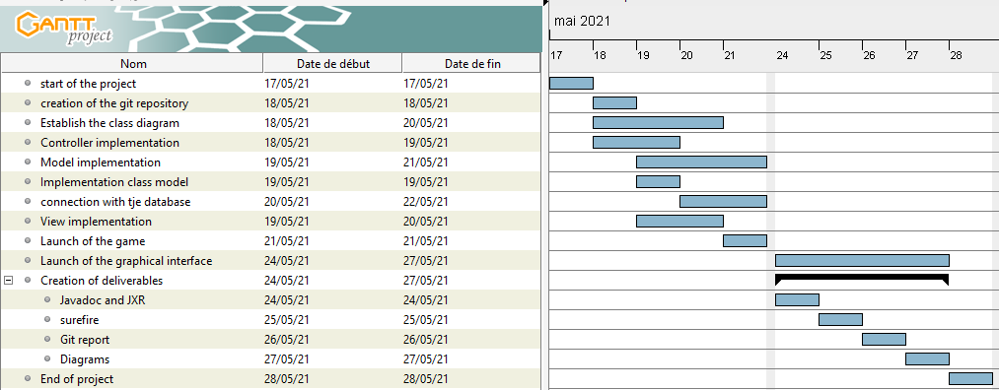
GANTT (1/2)
Provisional Planning

Slide 6
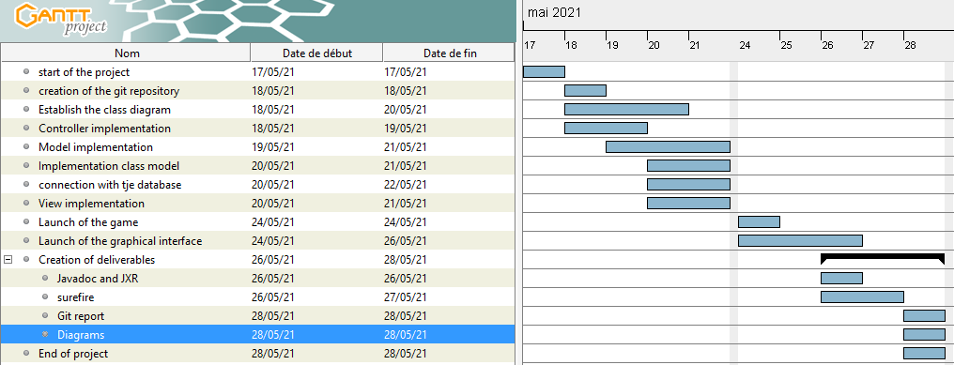
GANTT(2/2)
Final and Real Planning

Slide 7









DESCRIPTION OF THE TOOLS USED

Slide 8


APPLICATION PRESENTATION

Slide 9
UML DIAGRAMS
Class diagrams
Package diagram
Sequence diagram
Component diagram

Slide 10
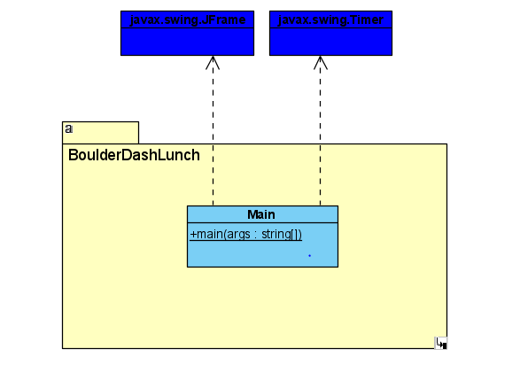
CLASS DIAGRAM
Main

Slide 11
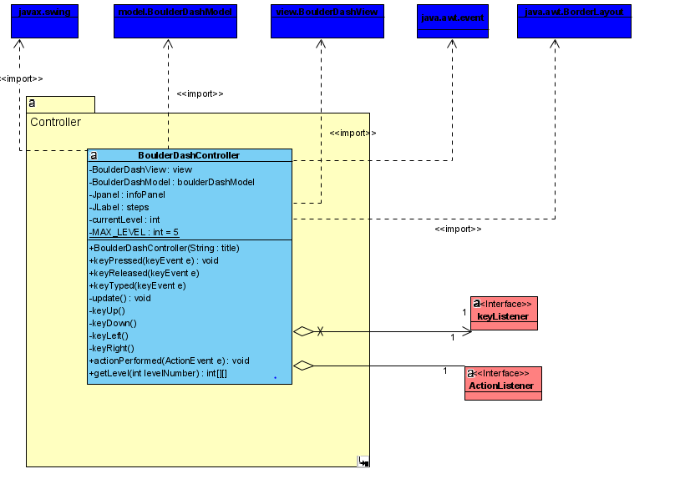
2. Controller

Slide 12
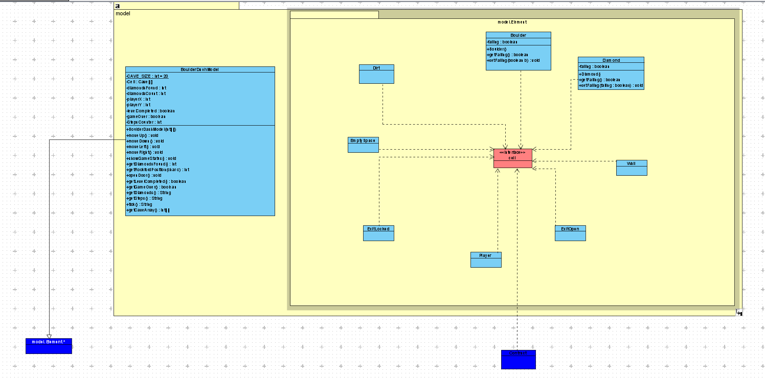
Model

Slide 13
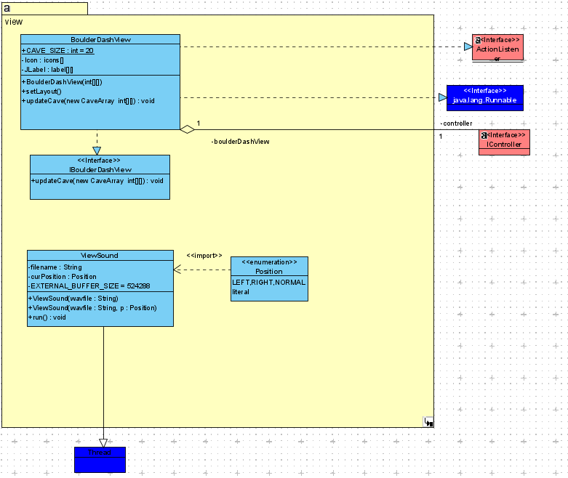
View

Slide 14
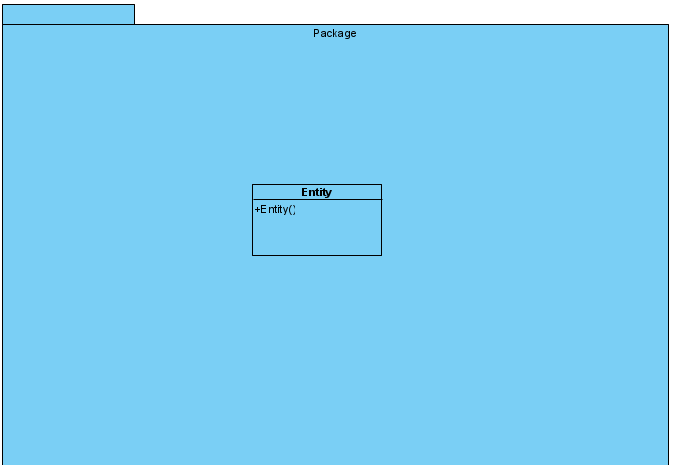
5.Entity

Slide 15
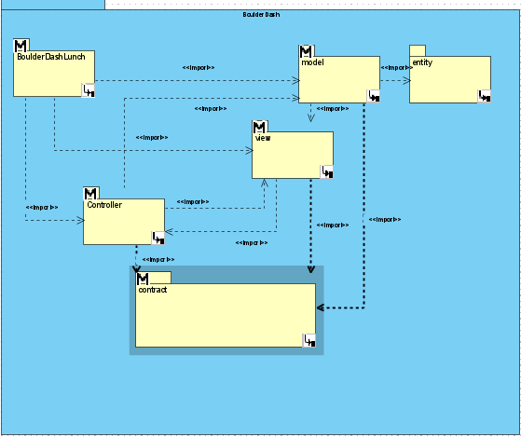
PACKAGE DIAGRAM

Slide 16
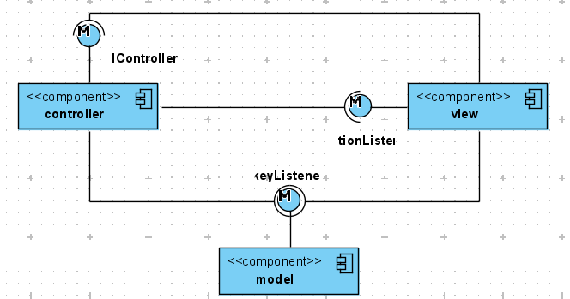
COMPONENT DIAGRAM

Slide 17
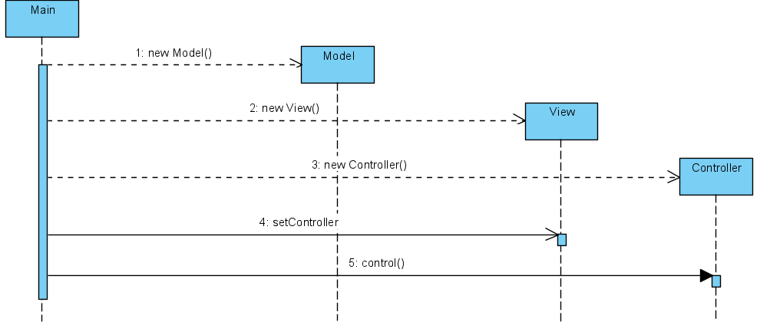
SEQUENCE DIAGRAM

Slide 18

Difficulties encounter during the projet
Reasons for the difficulties
How well can you remedy to the situation

